Slide 1
Bureaucratic Responsiveness to LGBT Americans
Makenzie Forster

Slide 2

The Study
Lowande, Kenneth, and Andrew Proctor. “Bureaucratic Responsiveness to LGBT Americans.” American Journal of Political Science 64, no. 3 (2020): 664–81. https://doi.org/10.1111/ajps.12493.
US Historical Precedent: Government officials fail to enforce civil rights legislation regarding racial equality.
Does this hold true for marriage equality?

Slide 3
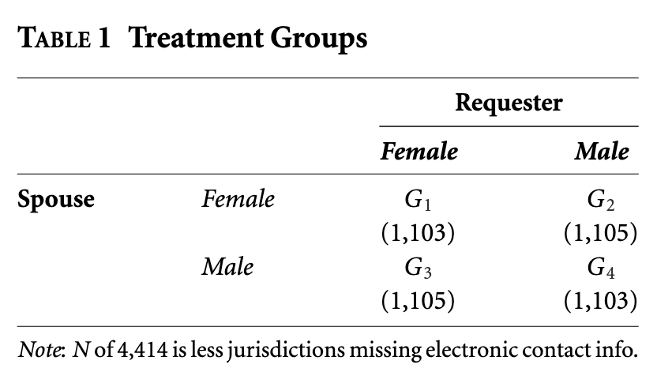

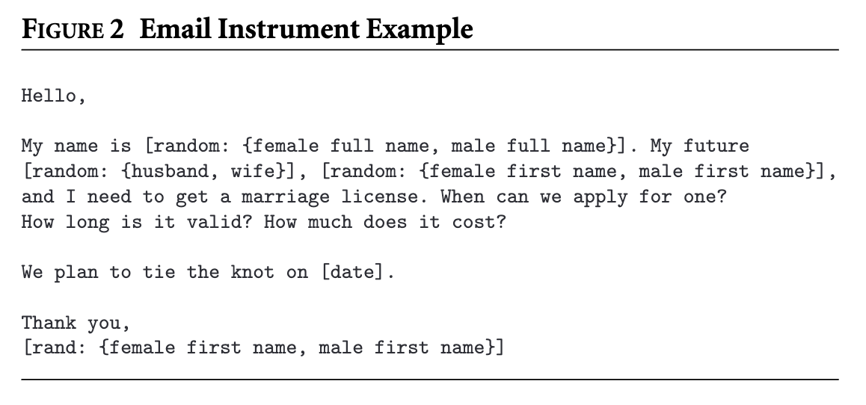
design
Email with 4 random name combinations, sent to random officials
Audit Experiment for Difference in Two Means

Slide 4

hypotheses
Discrimination Hypothesis: Licensers will be less responsive to same-sex requesters.
Legacy Hypothesis: Licensers in states with a recent legal history of limiting LGBT rights will be less responsive to same-sex requesters, relative to officials in other states.
Selection Hypothesis: Licensers who are elected will be less responsive to same-sex requesters in areas of higher local-level conservatism, compared with other requesters, relative to elected officials in liberal areas and appointed officials

Slide 5

measurement
Variables of Interest
Response
Congratulations
Covariates
Regional Same Sex Marriage History
Sodomy History
Population
Obama Vote Share
Appointment type: (elected, appointed, or other)
Governing Body issuing Marriage License (municipal or county level)
General Felicitations
Contact Form: whether official was contacted via online form or email

Slide 6
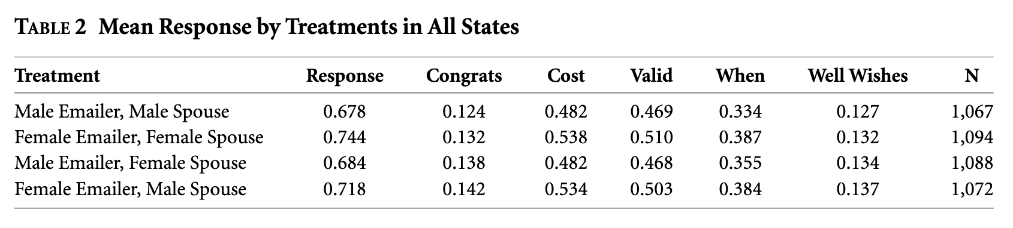

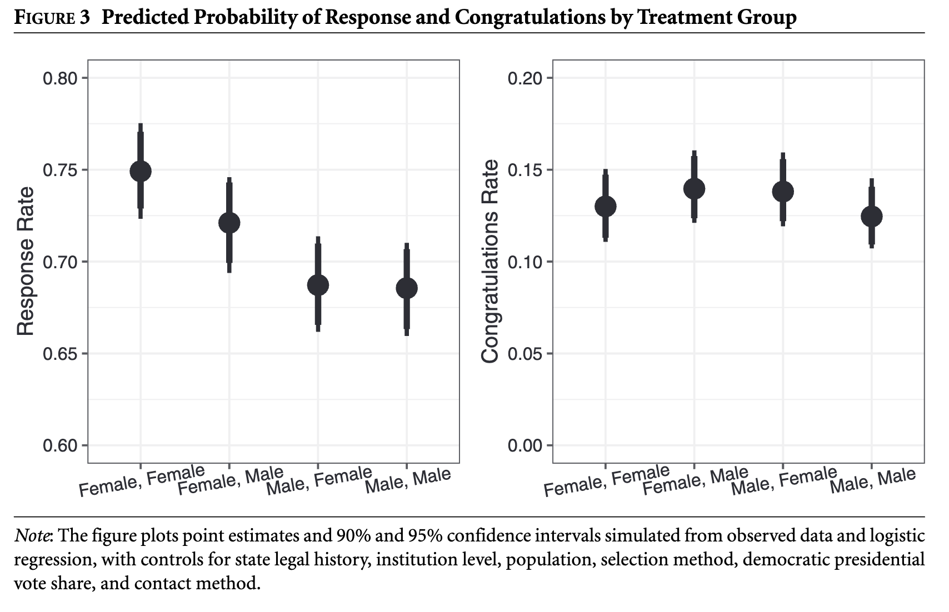
results
Not a statistically significant difference in response to gay vs straight couples
That’s What We Call a Win, Folks.

Slide 7

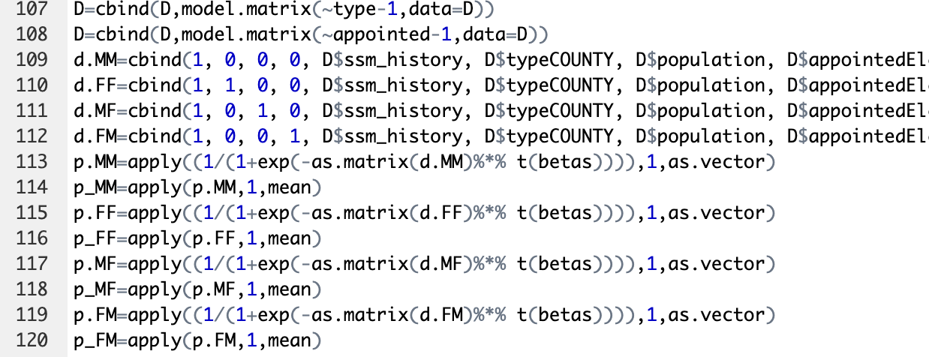
replication
Constructing 95% confidence intervals for point estimates using Inverse Probability Weighting using ssm_history, type, population, appointed, obamavote, & cf
It works, friends. ☺ The code ran.

Slide 8

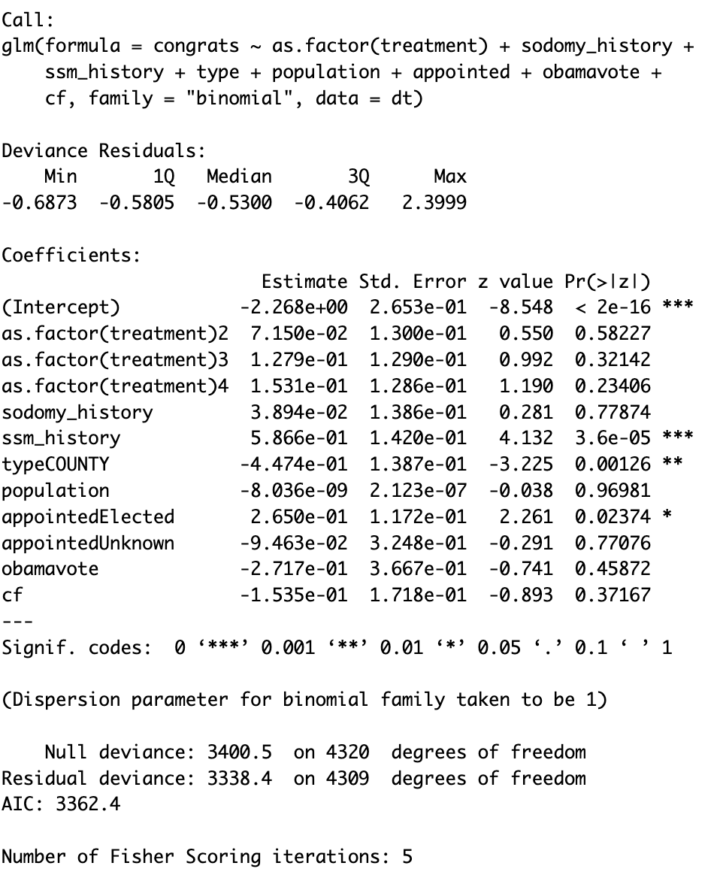
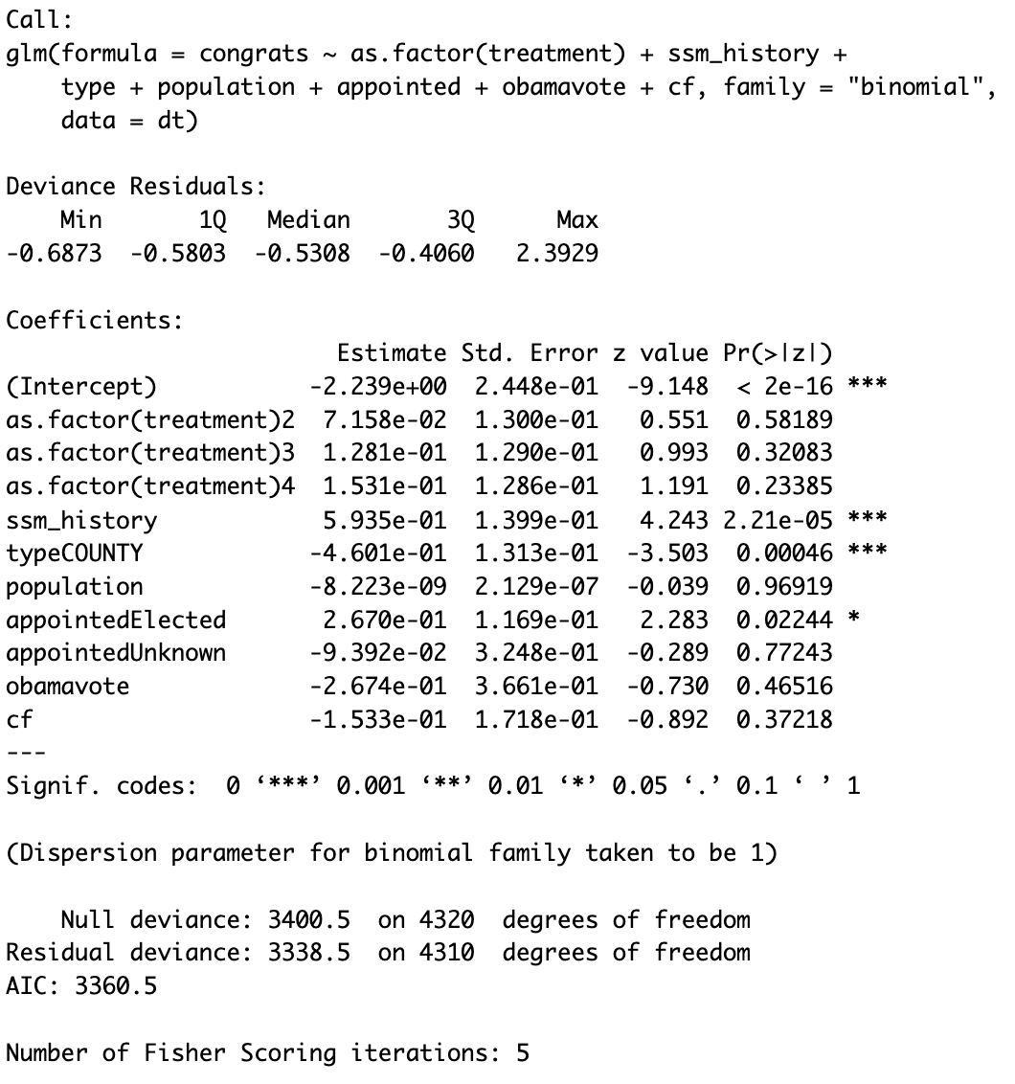
The ol’ razzle dazzle
Covariate ‘sodomy_history’ was not included in logistic regression, so I added it.
This contributed absolutely nothing to model fit; not a significant predictor.

Slide 9
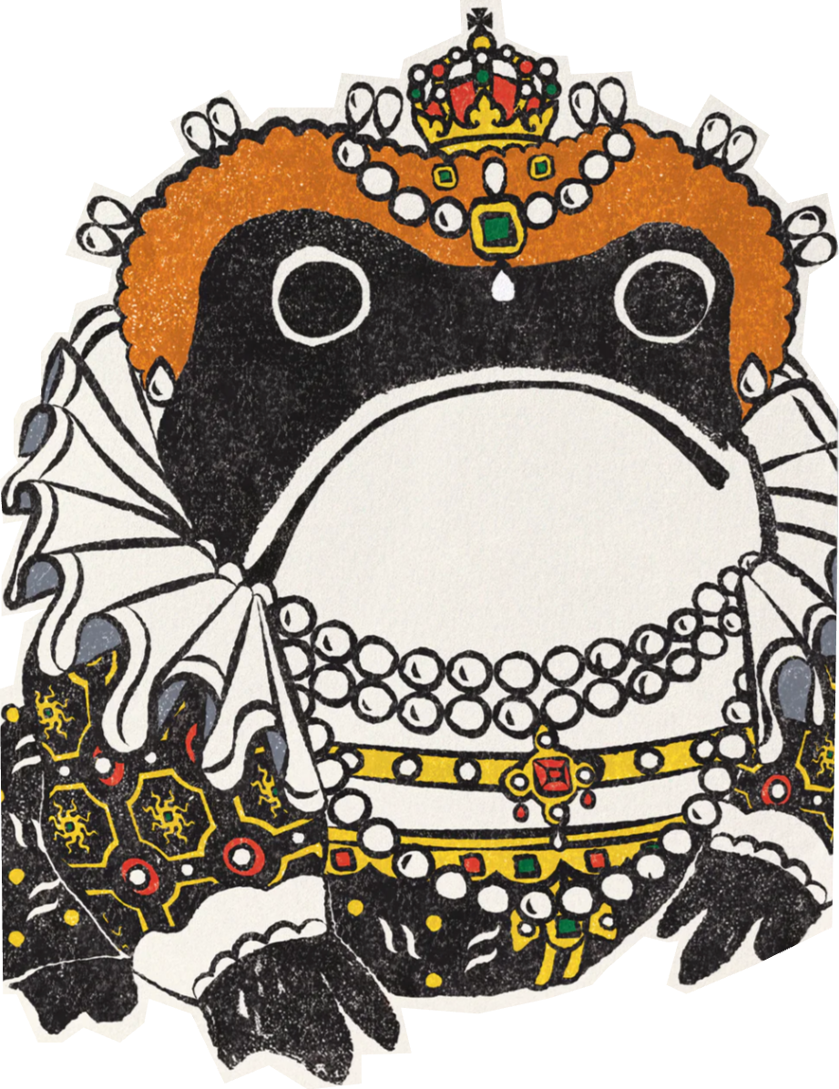
The ol’ razzle dazzle (Part ii)
Significance testing was neither reported in the paper, nor in the replication code. I ran T-tests on Response and Congrats for:
LGBT vs Straight:
R: p-value = 0.4567
C: p-value = 0.2429
Men vs Women:
R: p-value = 0.0002632
C: p-value = 0.5756
With A Little Bit of Data Wrangling

Slide 10

The ol’ razzle dazzle (Part iii)
More Significance Testing
Lesbian vs Straight Women:
R: p-value = 0.1764
C: p-value = 0.4915
Gay vs Straight Men:
R: p-value = 0.7569
C: p-value = 0.3299

Slide 11
That’s all, folks.

